Slide 1

AWS – CodePipeline
VishwanaTH m s
VISHWACLOUDLAB.ORG

Slide 2
Concepts of Codepipeline
AWS CodePipeline is a continuous delivery service you can use to model, visualize, and automate the steps required to release your software.

Slide 3
Benefits of Codepipeline
Automate your release processes.
Establish a consistent release process
Speed up delivery while improving quality
Use your favourite tools
View progress at-a-glance
View pipeline history details

Slide 4
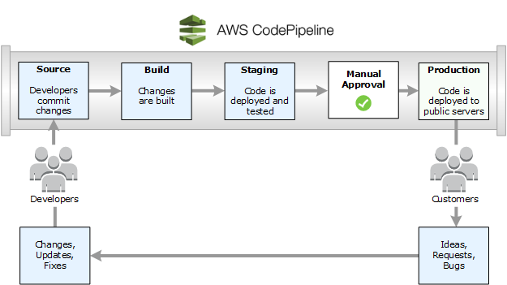
How Codepipeline work?

Slide 5
Terminology in Codepipeline
Pipelines
Actions
Stage Transitions
Monitoring pipelines

Slide 6
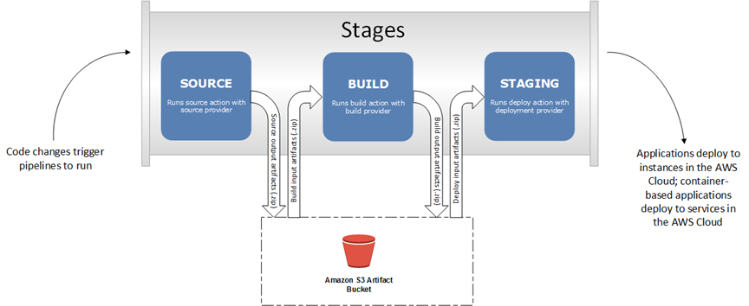
High-level artifact workflow between stages in AWS CodePipeline.

Slide 7
Use Cases of CodePipeline
Use AWS CodePipeline with Third-party Action Providers (GitHub and Jenkins)
Use AWS CodePipeline to Compile, Build, and Test Code with AWS CodeBuild
Use AWS CodePipeline with Amazon ECS for Continuous Delivery of Container-Based Applications to the Cloud
Use AWS CodePipeline with Elastic Beanstalk for Continuous Delivery of Web Applications to the Cloud
Use AWS CodePipeline with AWS Lambda for Continuous Delivery of Lambda-Based and Serverless Applications
Use AWS CodePipeline with AWS CloudFormation Templates for Continuous Delivery to the Cloud

Slide 8
CodePipeline Pricing
With AWS CodePipeline, there are no upfront fees or commitments.
AWS CodePipeline costs $1.00 per active pipeline* per month.
Pipelines are free for the first 30 days after creation.
An active pipeline is a pipeline that has existed for more than 30 days and has at least one code change that runs through it during the month.

Slide 9
Reference links.
https://docs.aws.amazon.com/codepipeline/latest/userguide/welcome.html
https://docs.aws.amazon.com/codepipeline/latest/userguide/troubleshooting.html

